Slide 1
COVID 19 Positive Test Results Across the U.S
By Anuj Patel

Slide 2
Questions
How many positive COVID test results have there been over time?
Which regions have been affected the most?
When was the peak of results?

Slide 3
Introduction
Using a data set found online at healthdata.gov, analysis of Positive COVID results was conducted from a period between March and October.
All 4 regions in the US (Northeast, Midwest, South, and West) were analyzed.
All analysis was conducted using R.

Slide 4
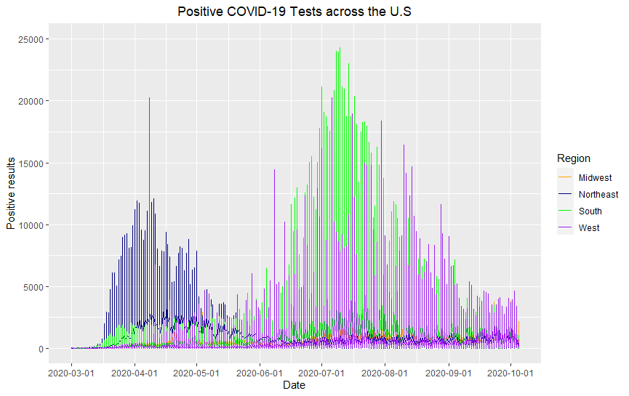
Overall Plot
From this plot we can states in the South have had the most positive results, closely followed by states in the West.

Slide 5
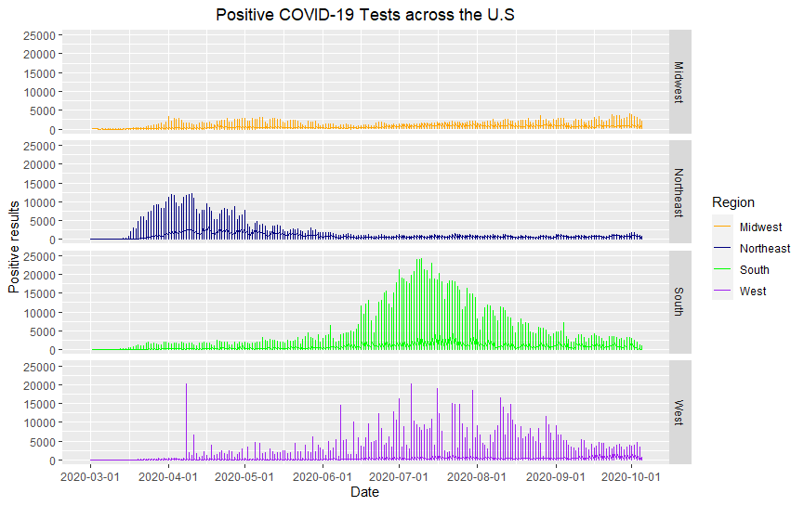
Faceted plot
Here we can see states in the Midwest had no spikes during the entire period and was consistent with its results along with the number of positive test results being below the other states. There was no real peak in the results.

Slide 6
Faceted plot
Here we can see states in the Northeast had an early spike between Mid-March to Mid-May with the peak being in April to Mid-April, but results were relatively calm after.

Slide 7
Faceted plot
Here we can see states in the South had low amounts of positive results early on but saw a huge spike between Mid-June to Mid-August with the peak being in Mid-July.

Slide 8
Faceted plot
Here we can see states in the West had an early spike in Mid-April, followed by a decrease, after which multiple fluctuations were recorded until September where results finally started to settle.

Slide 9
Notes
Graphs may be skewed due to multiple reasons.
Not all states have been reporting their results daily which is why some spikes, or lack of, may have appeared more drastic then they actually were.
The graphs are based on new results reported, not total results over the time period.
The testing procedures may have improved over time therefore giving more positive results later on and there could be a significant number missed in the earlier months.
The graph has been limited to 25000 results for viewing purposes. Some states reported as many as 45000 positive results in 1 day.

